Slide 1
Dota 2 Shopkeeper’s Quiz

Slide 2
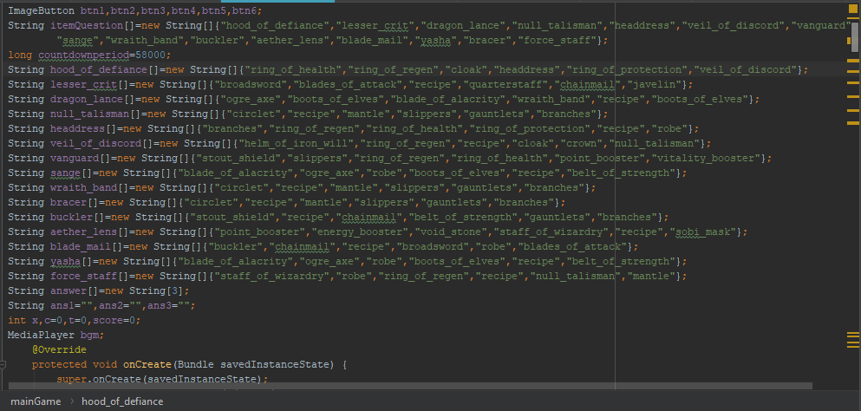
Declare Items

Slide 3
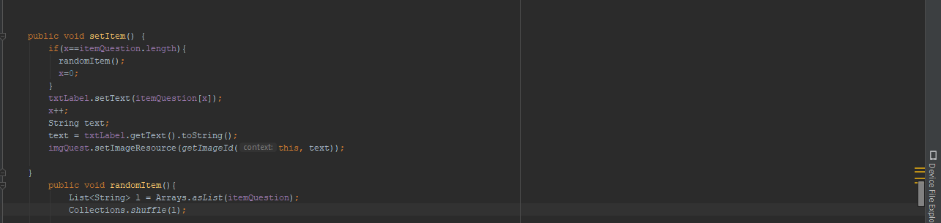
Set Question

Slide 4
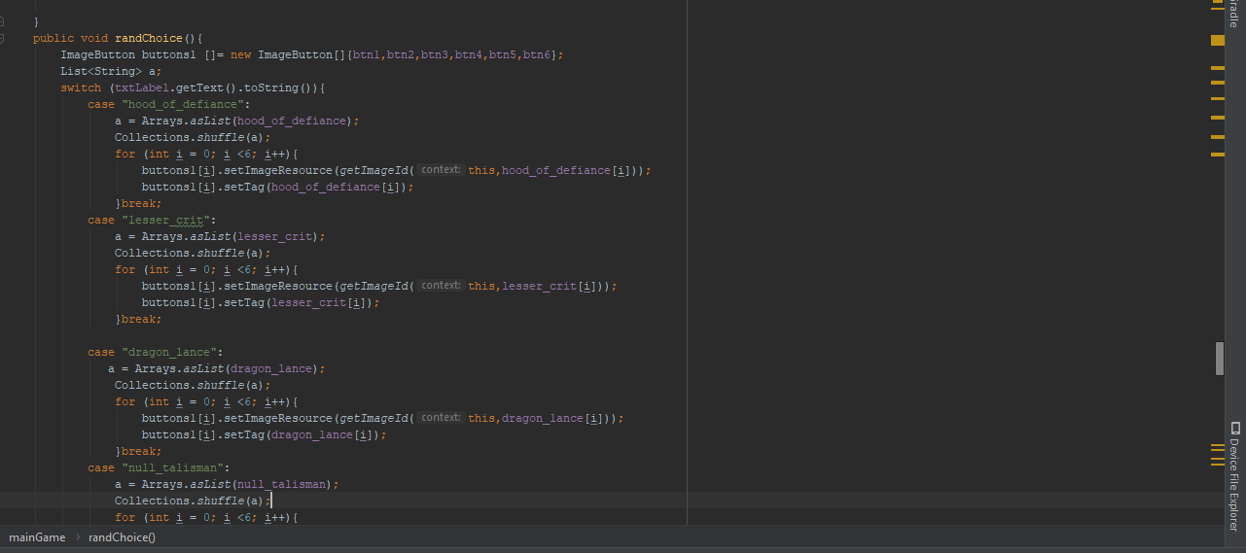
Random Choices

Slide 5
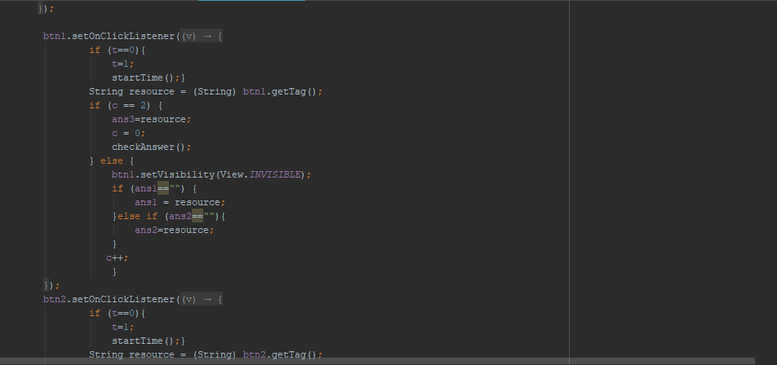
Choices

Slide 6
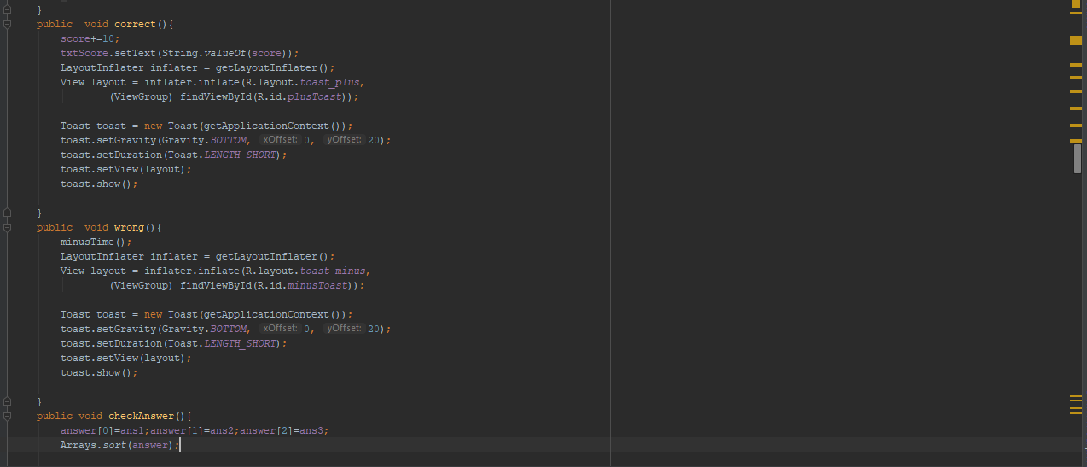
Check Answers

Slide 7
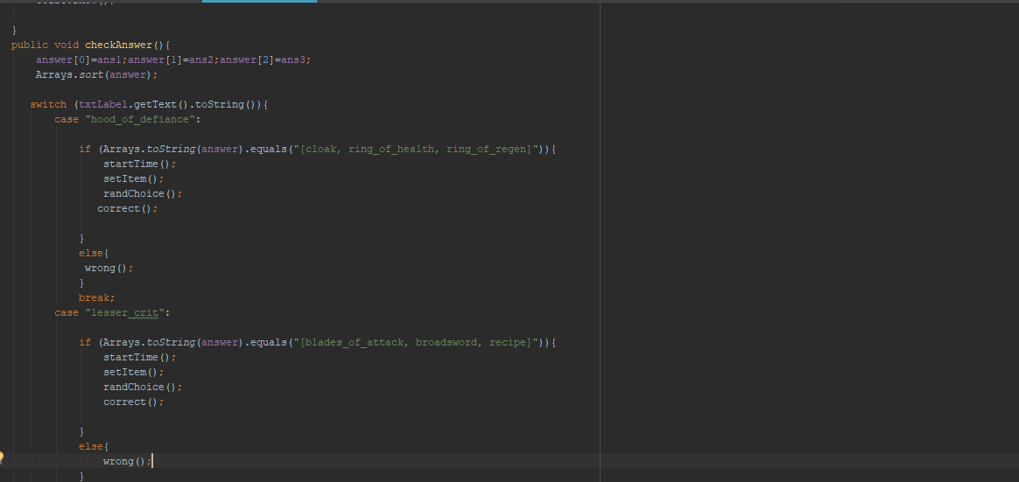
Check Answers

Slide 8
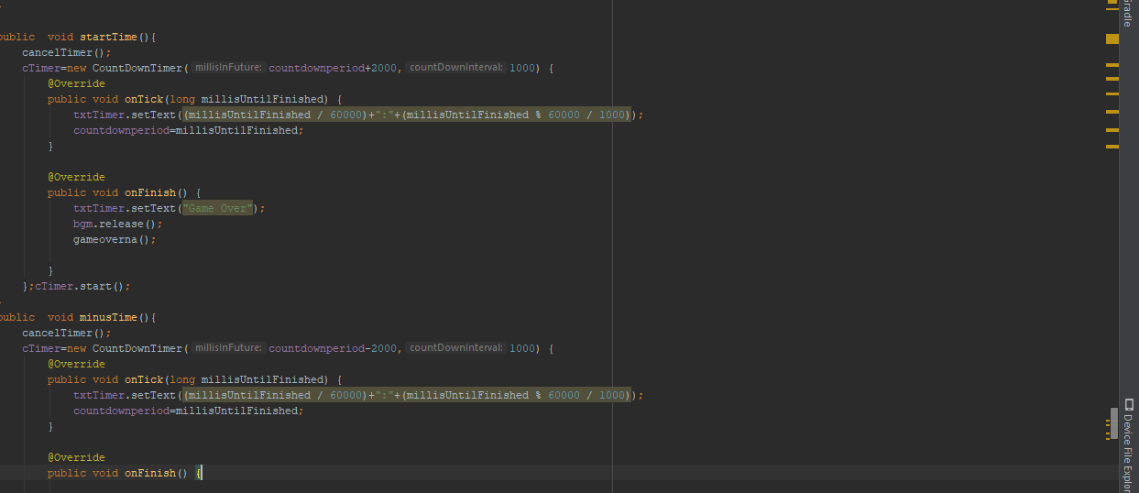
Add Time/Subtract Time

Slide 9
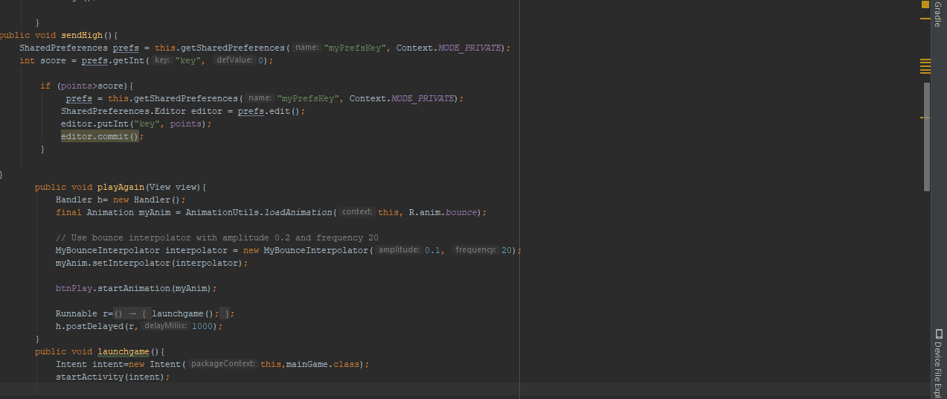
Get High Score

Slide 10
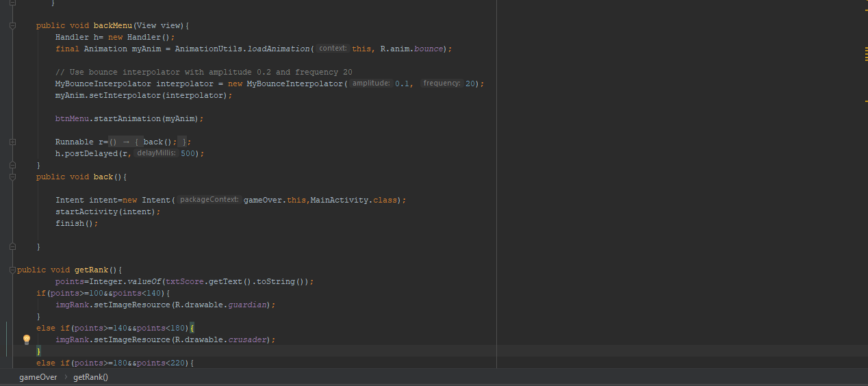
Get medal

